Slide 1

A Comparative Study of Solving Maze
The path-finding algorithms are:
BFS
A*
Greedy_BFS
Krishna Gopal Sharma
S3454618
Artificial Intelligence Foundations
CIS4049

Slide 2
Abstract and Introduction
This project investigates the performance of 3 search algorithms.
1. BFS: Explores level by level, guarantees finds the shortest path but explores more nodes.
2. A*: Uses a heuristic to guide search and finds optimal paths. A balances both optimality and exploration efficiency
3. Greedy BFS: Focuses on only heuristic for faster but less optimal results.
I chose this topic because graph search algorithms are important in solving real world problems like navigation, GIS, games and robotics. Maze solving is a simple way to understand and compare how algorithms like BFS, A*, and Greedy Best-First work. It helped me learn how they perform and where they are best used.

Slide 3

Methodology
The maze was created using the pyamaze library with dimensions 50 x 120.
Starting Position: (50, 120) the bottom right corner
Goal position: Three scenarios were defined with varying goal positions.
(1, 1), (49, 2), (1, 119).
Each algorithm was implemented in Python to compare pathfinding efficiency.
Exploration Length: How many cells explored while searching for path from start to goal
Path Length: How many cell are needed to reach the goal from start position.

Slide 4
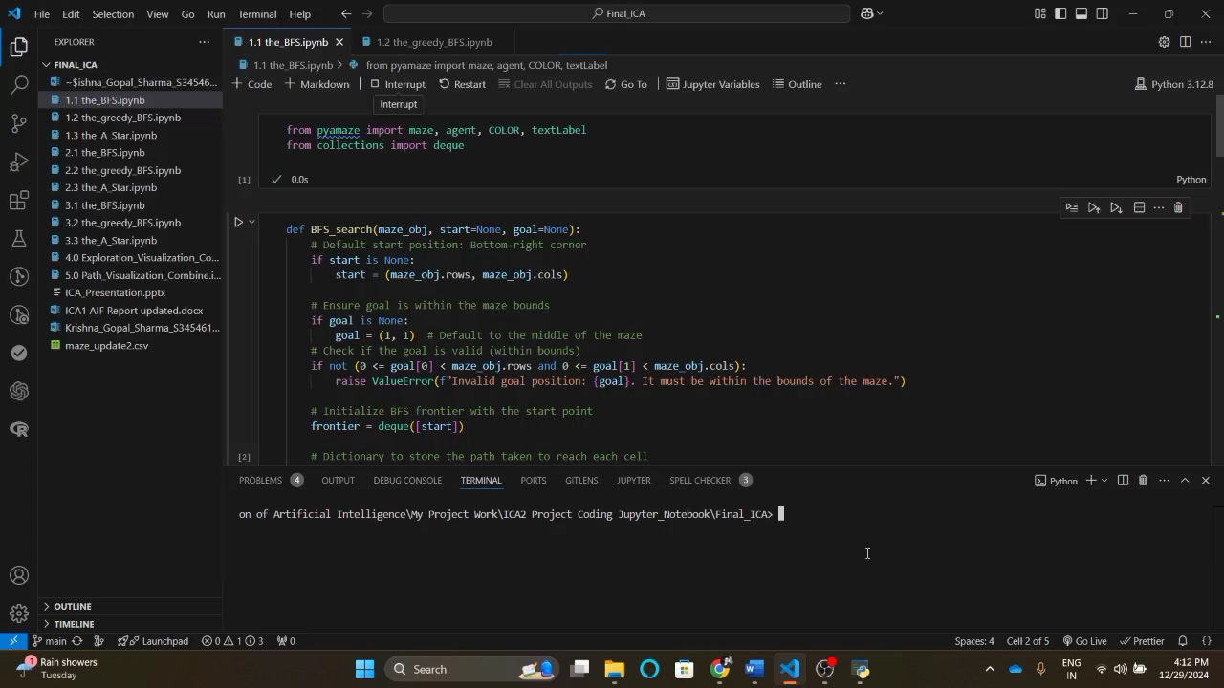
Breadth First Search Algorithm

Slide 5
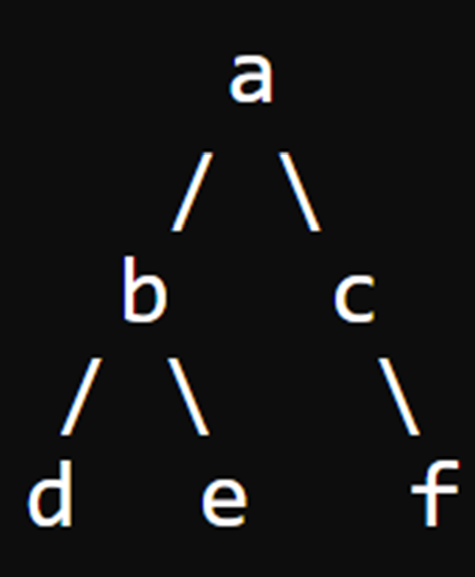
How BFS with a Deque Works on This Example:
Start at node a → We begin by adding a to the deque (which is like a waiting line) and mark it as visited → Deque = [a]
Process node a → Take a from the front of the deque and check its neighbors (b and c) → Since they haven't been visited, we add them to the back of the deque and mark them as visited → Deque = [b, c]
Process node b → Take b from the front of the deque → Check its neighbors (d and e) → Add d and e to the deque and mark them as visited → Deque = [c, d, e]
Process node c → Take c from the front of the deque → Check its neighbor (f) → Add f to the deque and mark it as visited → Deque = [d, e, f]
Process node d → Take d from the front of the deque → Since d has no unvisited neighbors, we move on → Deque = [e, f]
Process node e → Take e from the front of the deque → Since e has no unvisited neighbors, we move on → Deque = [f]
Process node f → Take f from the front of the deque → Since f has no unvisited neighbors, we’re done → Deque = [] (empty)

Slide 6
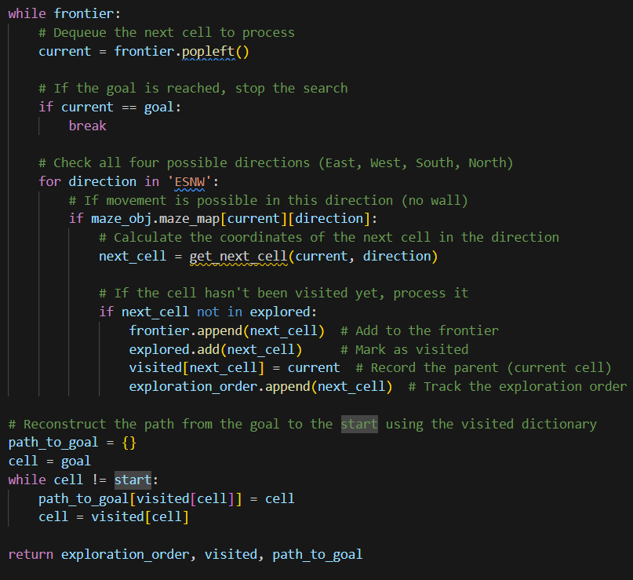
Breadth First Search Algorithm Explanation
Start at the root: BFS begins at the Start point and add this position to the deque. The deque will hold nodes to be processed.
Deque for tracking nodes: A deque allows us to efficiently add nodes to both ends, but in BFS, us typically add new nodes to the back of the deque for processing in the correct order (FIFO).
Explore neighbors: For the current node, BFS explores all unvisited neighboring nodes and adds them to the back of the deque.
Mark visited nodes: Each node is marked as visited when added to the deque, ensuring that the same node is not processed multiple times.
Level-by-level traversal: Nodes are processed in the order they were added, ensuring BFS checks one level completely before moving to the next, making it suitable for finding the shortest path.

Slide 7
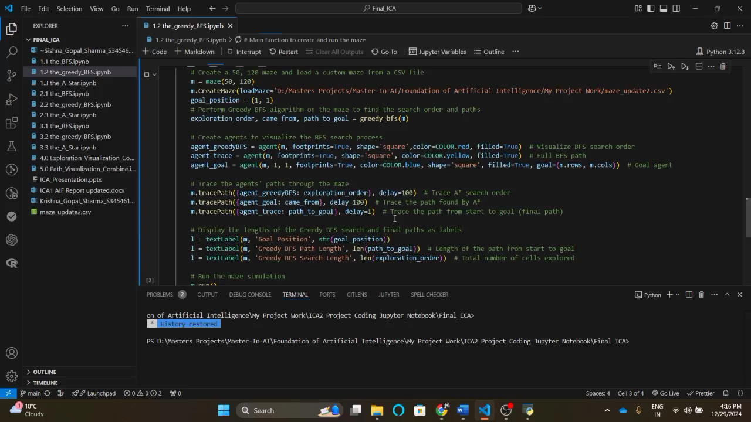
Breadth First Search Algorithm
Greedy Breadth First Search Algorithm

Slide 8
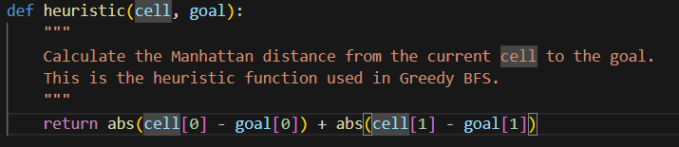
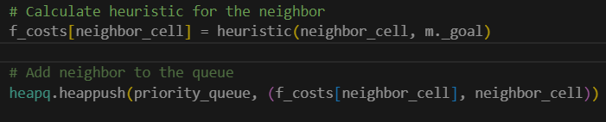
Greedy BFS Algorithm Explanation
Here I use Manhattan Distance to calculate the heuristic value of each cell. Let’s suppose:
→ if, {(5, 5) start cell, (1, 1) goal cell}
= abs(5-1) + abs(5-1) = 4 + 4 = 8
→ if, {(3, 5) ) start cell, , (1, 1)) goal cell}
= abs(3 - 1) + abs(5 - 1) = 2 + 4 = 6
Why is the Heuristic Recalculated each time ?
In Greedy BFS, the heuristic function is used to prioritize which cell to explore next. The algorithm needs to know the current "closeness" of each cell to the goal whenever it is considered for exploration. Since the search proceeds continuously, the heuristic is recalculated at every step with respect to the current position in the maze and the goal's position of an agent.

Slide 9
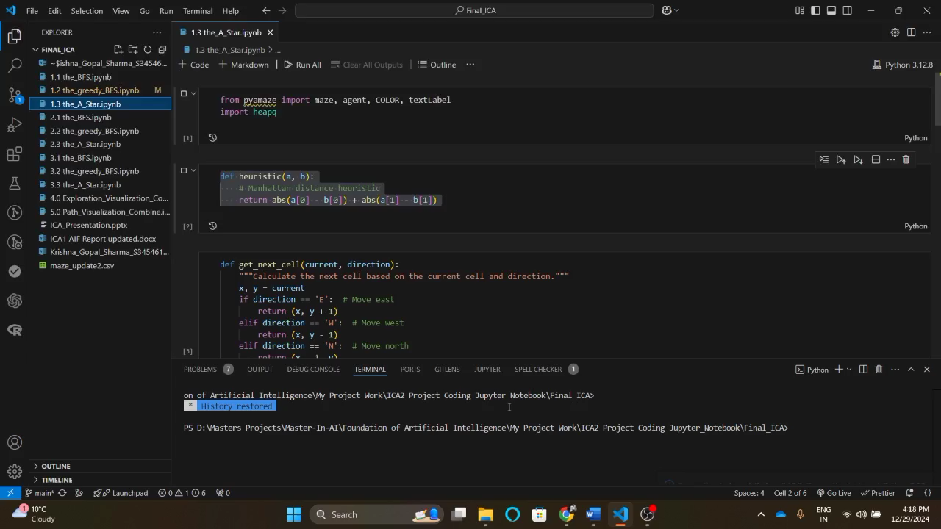
A* Search Algorithm

Slide 10
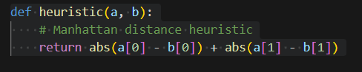
A* Search Algorithm Explanation
To calculate the heuristic value here I use same Manhattan Distance.
In A* Algorithm the Total Cost(fn) = path cost(gn) + Heuristic cost(hn).
fn = (gn + hn)
This including of path cost make the algorithm highly optimistic.
How adding (gn) and (hn) make the A* more optimal algorithm?
Well, (hn) means how far the agent is from the goal, and (gn) means how far we had come from start, this cause a balance between fast and cost. In statistic it is known as an equilibrium, where the step are calculating along with the cost of each step to reach the goal. That’s make the A* the optimal algorithm.

Slide 11
Result and Discussion
In all three scenarios, A* has given the shortest path and explores fewer cells compared to BFS. BFS finds the shortest path but explores many more cells. Greedy BFS explores the least cells but often gives a longer path.
Scenario | Algorithms | Goal Position (cell No) | Path Length | Exploration Length
1 | BFS | (1, 1) | 189 | 5991
 | Greedy_BFS | (1, 1) | 229 | 401
 | A* | (1, 1) | 189 | 4264
2 | BFS | (49, 2) | 174 | 5707
 | Greedy_BFS | (49, 2) | 204 | 331
 | A* | (49, 2) | 174 | 2358
3 | BFS | (1, 119) | 83 | 2253
 | Greedy_BFS | (1, 119) | 101 | 152
 | A* | (1, 119) | 83 | 657
Scenario 1: BFS and A* found the same shortest path (189), but BFS explored many more cells. Greedy BFS had a longer path but explored fewer cells.
Scenario 2: BFS and A* again had the same path (174), but BFS explored more cells. Greedy BFS had a longer path but explored the fewest cells.
Scenario 3: BFS and A* both found the shortest path (83), but BFS explored more cells. Greedy BFS found a longer path with very few explored cells.

Slide 12
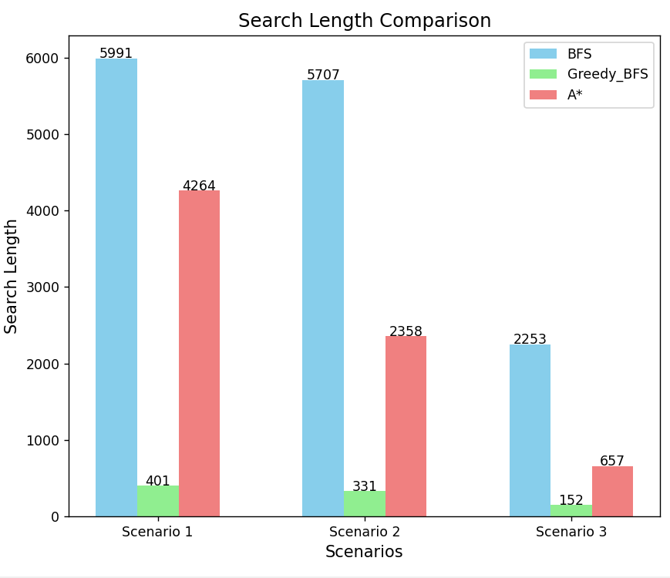
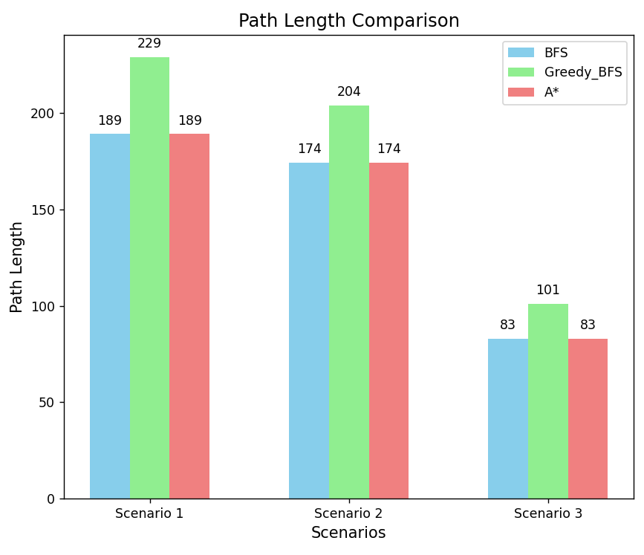
Search Length Comparison with all 3 Scenarios
Path Length Comparison with all 3 Scenarios

Slide 13
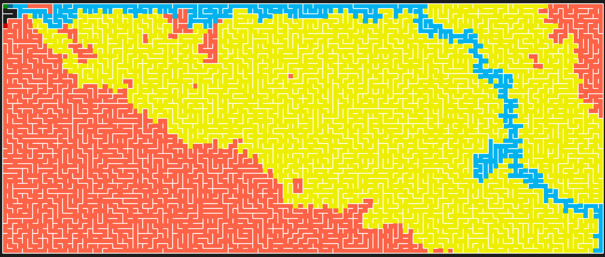
BFS
A*
Greedy_BFS
Exploration path comparison of all algorithms with goal position (1, 1)
Here, BFS explore more cells as compared to A* and Greedy_BFS.
Greedy_BFS is working as per its name, fast and greedy, less optimal.
A* is perfect for this maze in all 3 scenarios. Why we need a BFS or Greedy_BFS, if A* is giving us the best result?

Slide 14
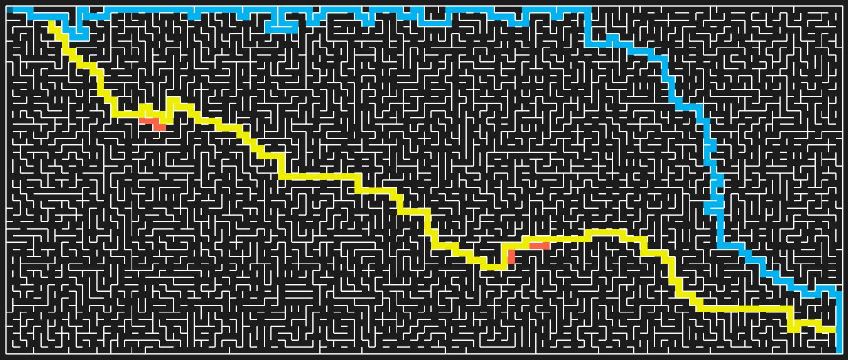
BFS
A*
Greedy_BFS
Goal path comparison of all algorithms with goal position (1, 1)
A* and BFS has same path length = 189 but different paths.
Greedy_BFS follows different path as compared to A* and BFS.
Does Greedy_BFS always follow this way for path…?

Slide 15
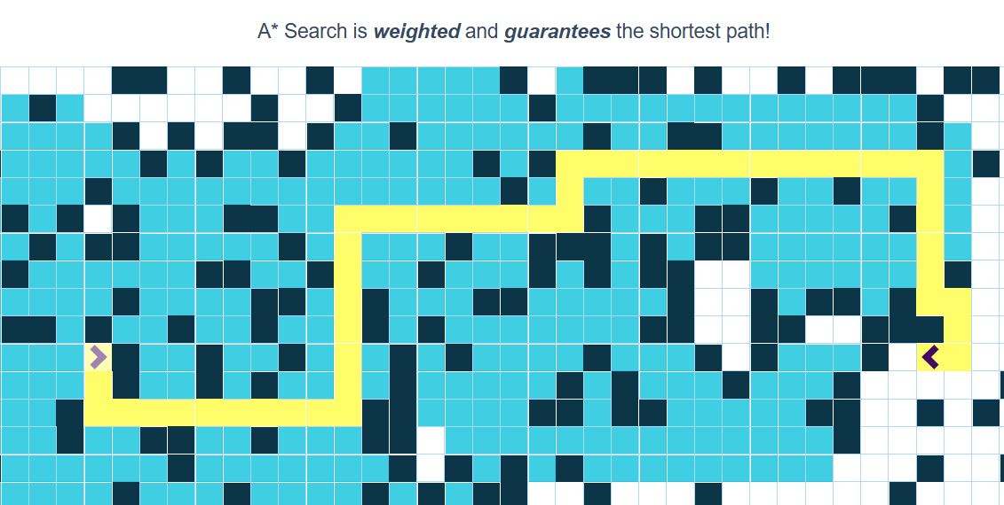
Source: Pathfinding Visualizer
Path Length = 49

Slide 16
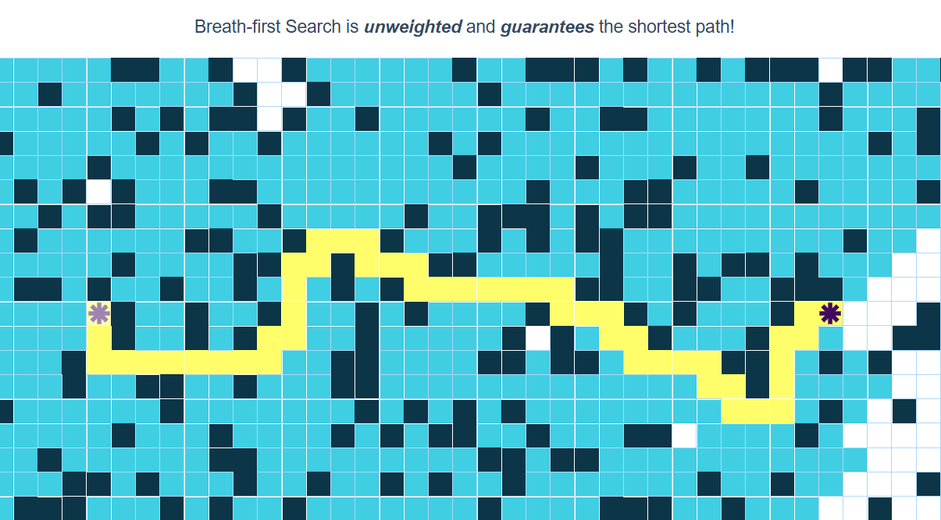
Source: Pathfinding Visualizer
Path Length = 47

Slide 17
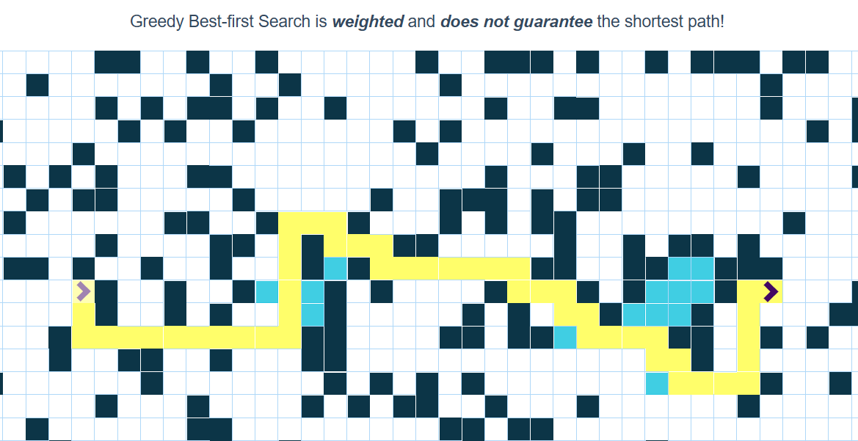
Source: Pathfinding Visualizer
Path Length = 47

Slide 18
Conclusion and Future Works
1. Conclusion
BFS is exhaustive and guarantees the shortest path but is computationally expensive in terms of explored nodes.
Greedy BFS is faster but sacrifices optimality, often leading to longer paths.
A* offers a balanced approach, finding the optimal path efficiently by exploring fewer nodes.
2. Future Work
Experiment with different heuristics for A*, like Manhattan and Euclidean, to see how they impact performance.
Compare BFS, Greedy BFS, and A* with other algorithms like IDDFS (Iterative Deepening DFS) and Dijkstra's Algorithm in different scenarios.
Explore the impact of obstacles or non-uniform cost grids to add complexity and realism to search problems.

Slide 19

Thank You
Any Questions?

